Slide 1

M202A Project Presentation BLE-enabled HID based on Edge Inference Accelerated Handwriting Recognition
Group members:
Yu Nong
Hanlong Chen

Slide 2


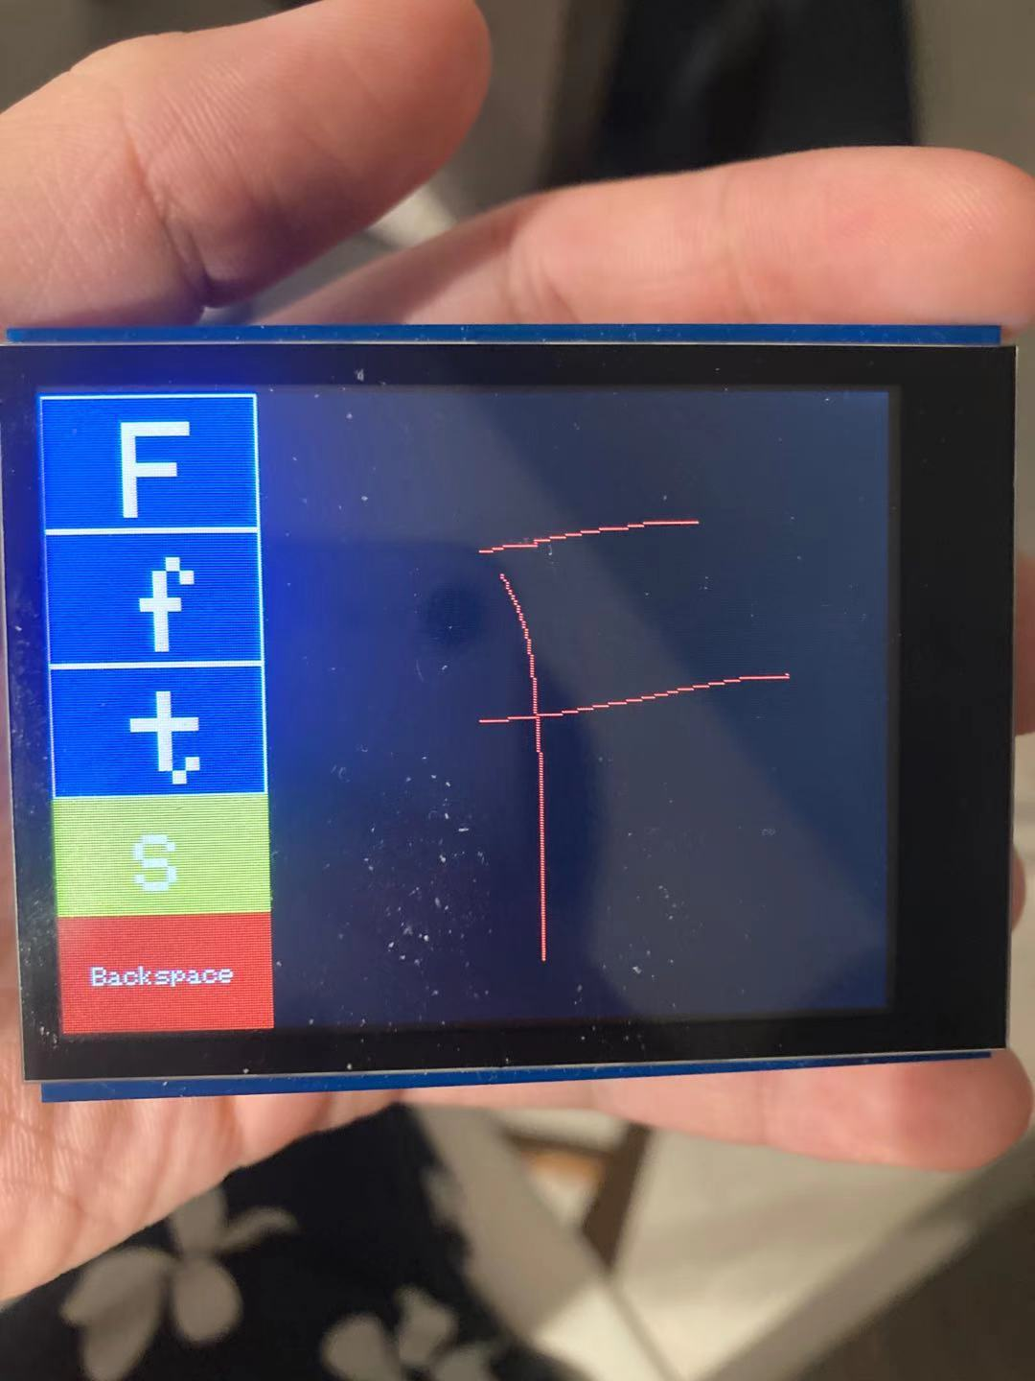
Background & Project goals
Goals: Build a real-time handwritten character recognition system based on Arduino Nano 33 BLE Sense with a touch screen where ML runs on edge.
Expected Performance:
Accuracy: ~85%
Inference Latency: ~150ms
BLE

Slide 3
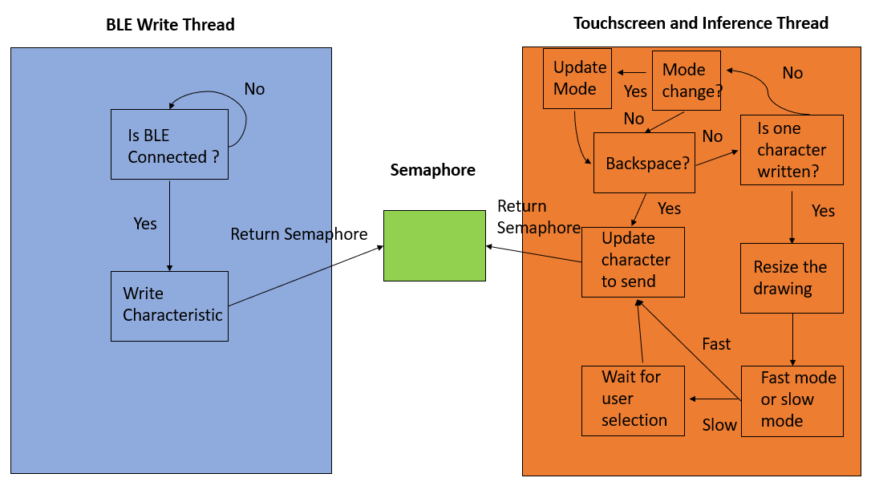
Technical Approach - Firmware
2 Thread with 1 semaphore
Write the inferred character to characteristic of BLE keyboard service to send keyboard stroke.
30 ms debounce for touchscreen to overcome the limit of SPI clock speed. Estimate the trajectory using Bresenham's algorithm.
Box sampling to downscale image.
2 operation mode with different focus.

Slide 4
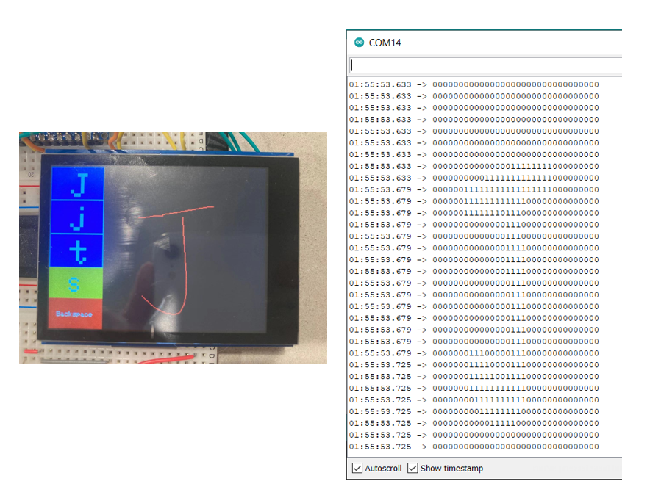
Technical Approach - Image Downscaling
Convert 240×240 image to 32×32 to accommodate the limited computing power.
Box sampling for efficiency with threshold at 0.
To further reduce latency, stop summing when the first 1 is met.
Improve performance by artificially increasing the stroke thickness.

Slide 5
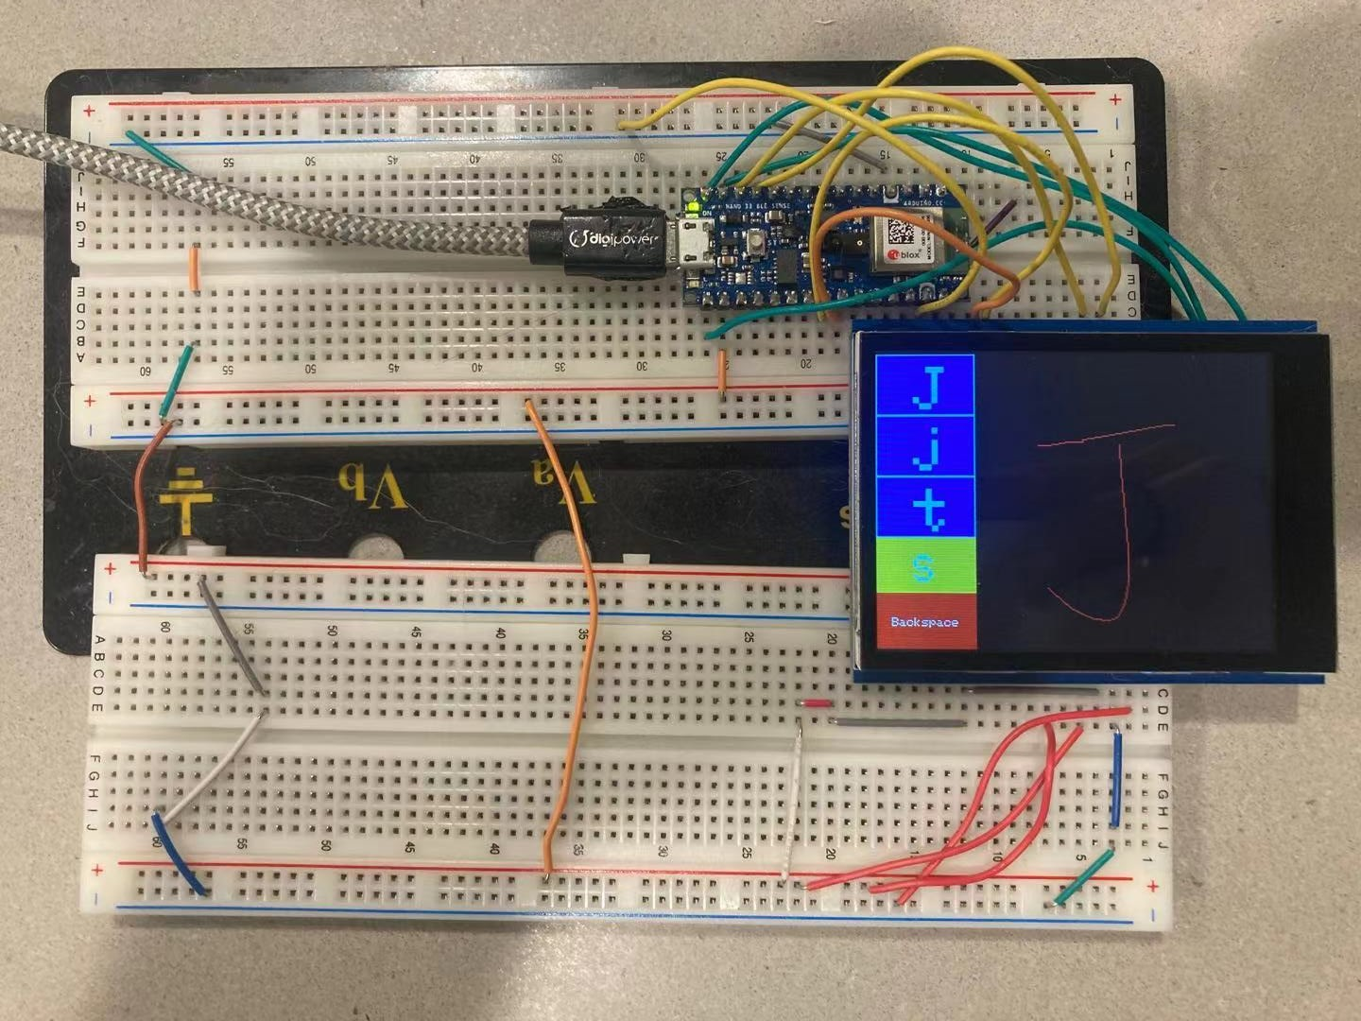
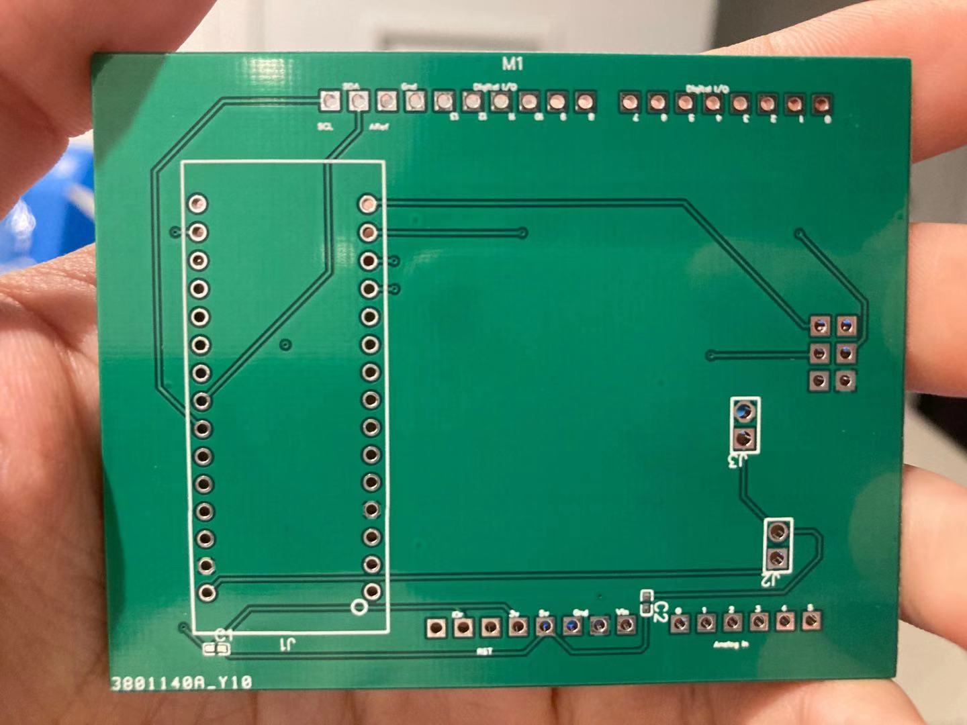
Technical Approach - PCB

Slide 6
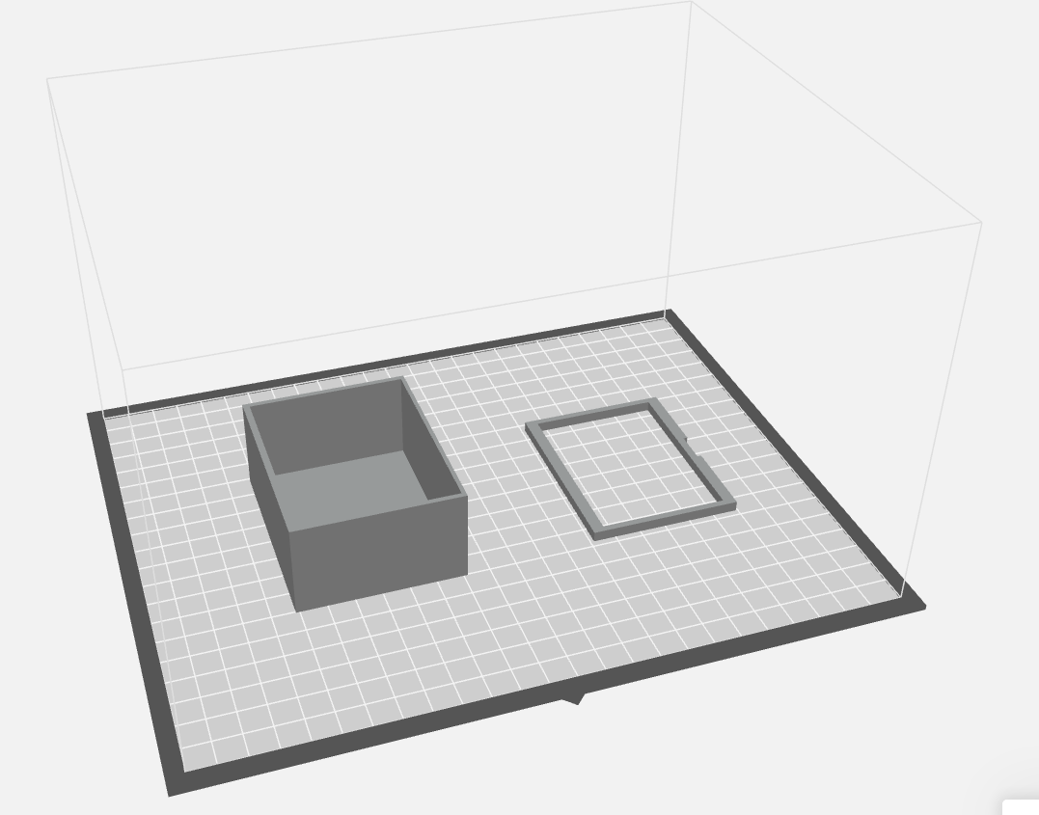
Technical Approach - Packaging

Slide 7
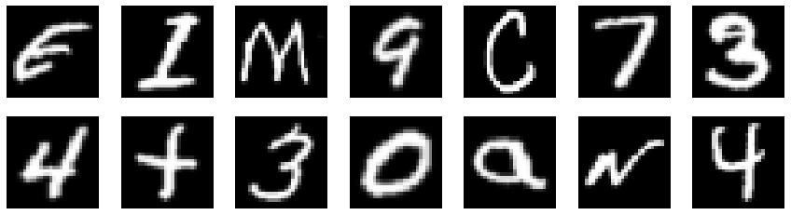


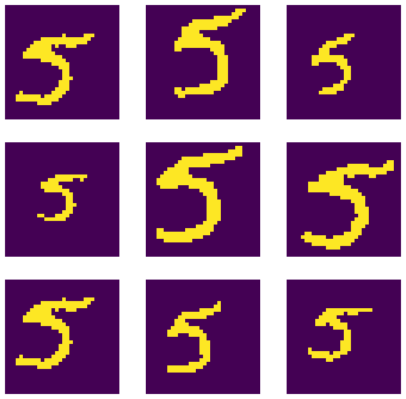
Technical Approach - Deep Learning
EMNIST dataset ~800,000 samples
Random rotation
Random resizing
Random cropping
Image binarization
Rescaling to float

Slide 8
Technical Approach - Deep Learning cont’d
# of params: 11,160
Training accu: 81.59%
Valid accu: 83.64%
Adam optimizer
Inference time: 114ms

Slide 9
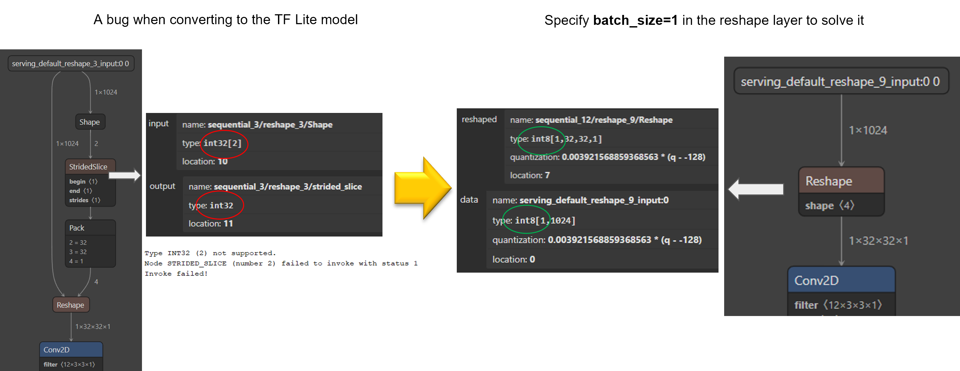
Technical Approach - Deep Learning cont’d
✔
Quantization
Quantization aware training
Pruning
❌
❌

Slide 10
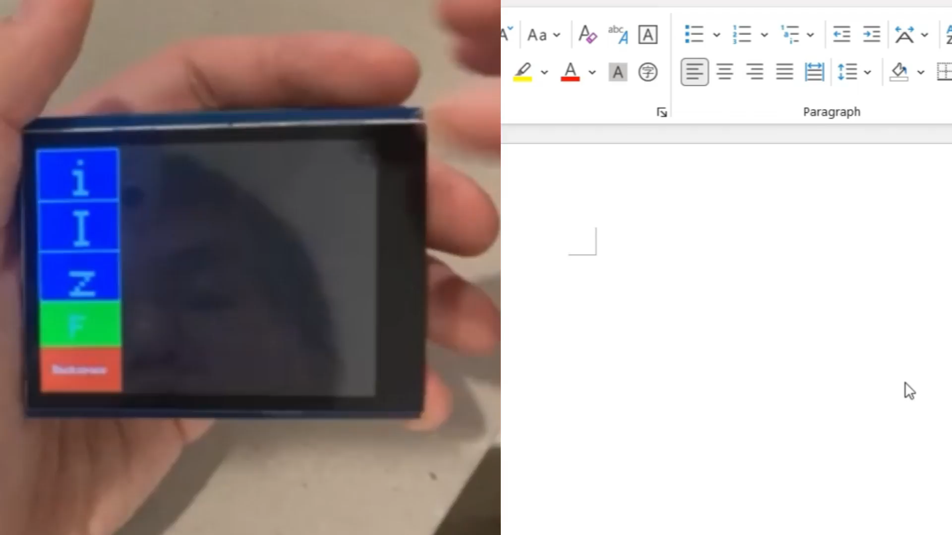
Evaluation-Fast mode

Slide 11
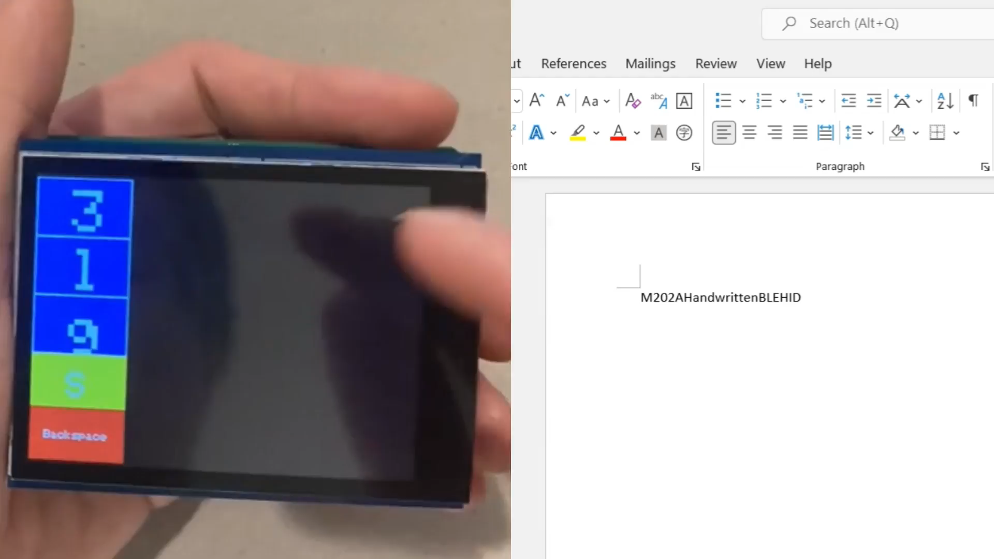
Evaluation-Slow mode

Slide 12
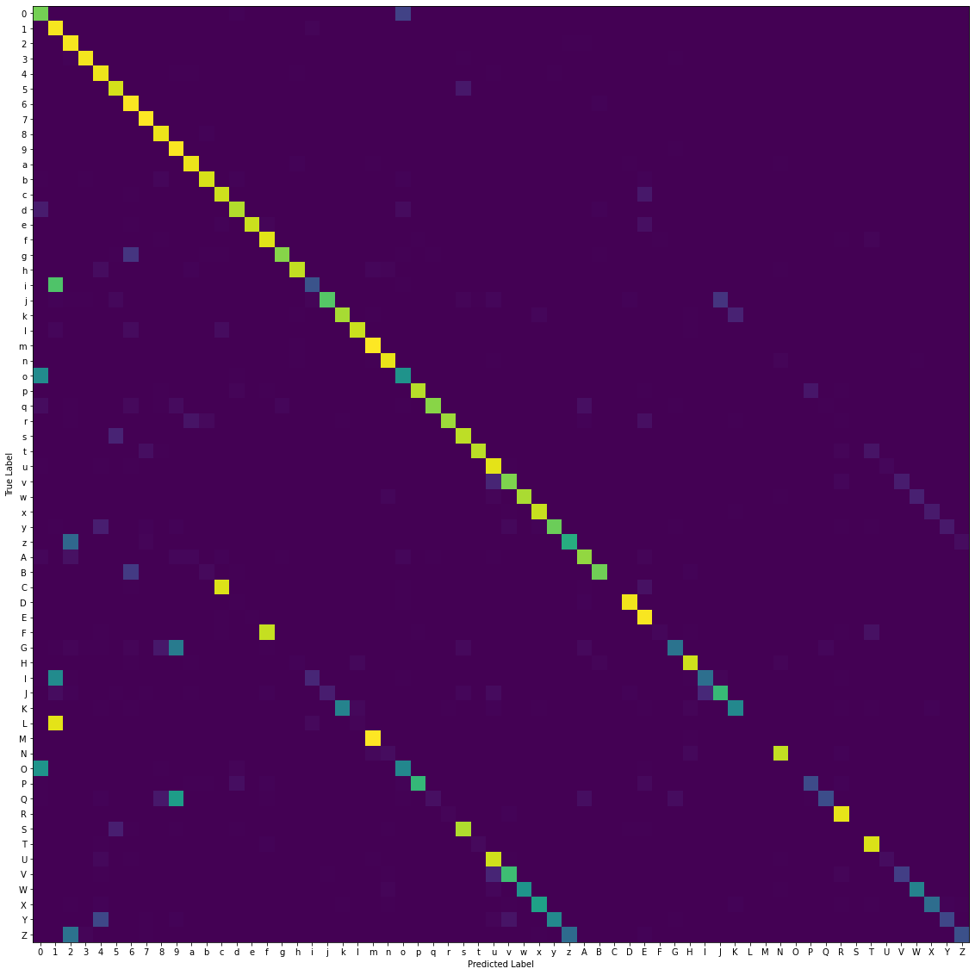
Evaluation-Accuracy
Quantized model
EMNIST Dataset
83.71%

Slide 13
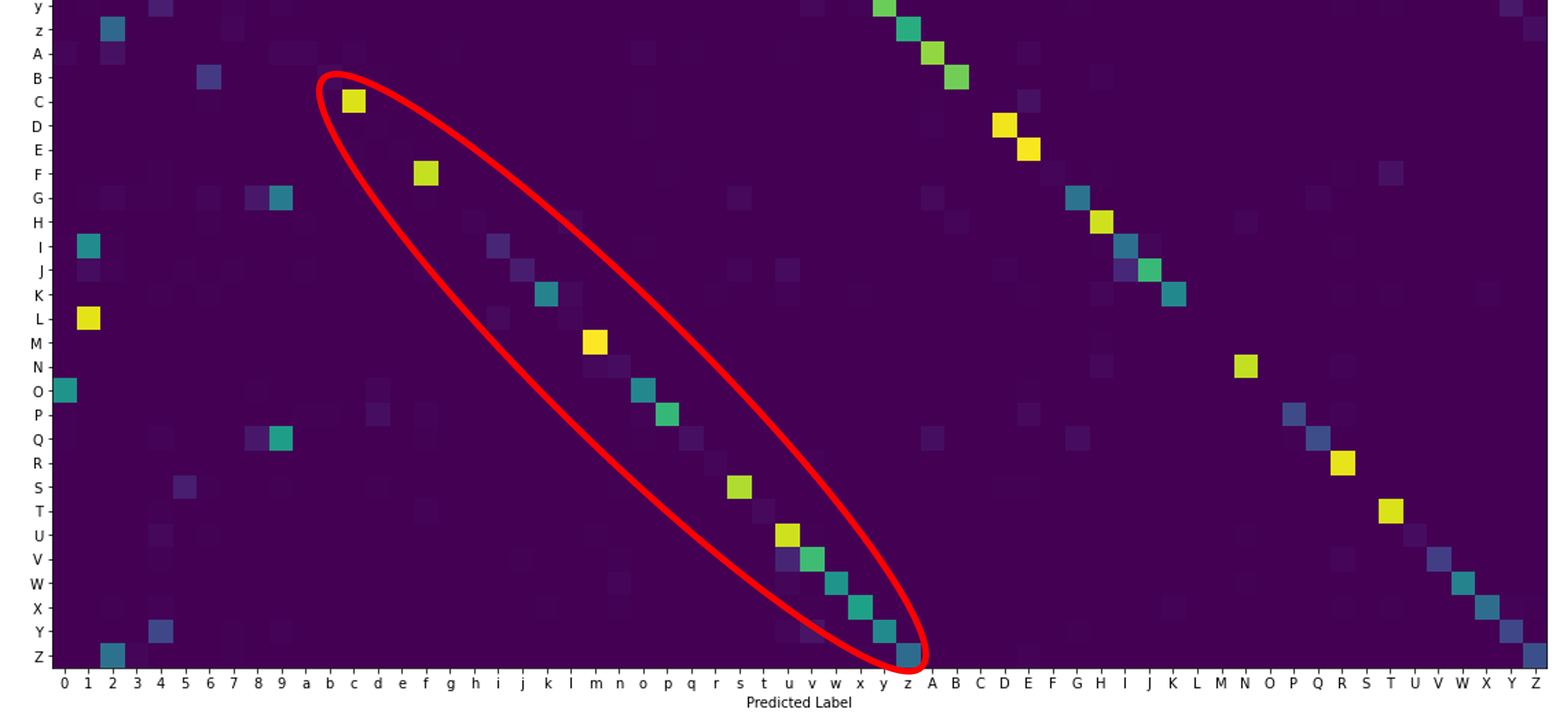
Evaluation-Accuracy
Confusion between uppercase and lowercase letters
X and x
O and o
S and s
Confusion between numbers and letters
1 and l
0 and O
2 and Z
Confusion between uppercase and lowercase letters

Slide 14
Evaluation-Accuracy
Evaluate the performance on fast and slow mode.
Slow mode: the written character has top-3 score during inference.
Fast mode: the written character has highest score during inference.
Write each characters for 5 times and calculate the average accuracy.
Fast mode: 80.6%
Slow mode: 95.4%

Slide 15
Evaluation-Latency
Evaluate the total latency in fast mode.
Record the time from user finished writing until BLE write command is sent out.
Calculate the average latency over 50 trails.
Average total latency: 208.1ms
Inference latency: 114ms

Slide 16
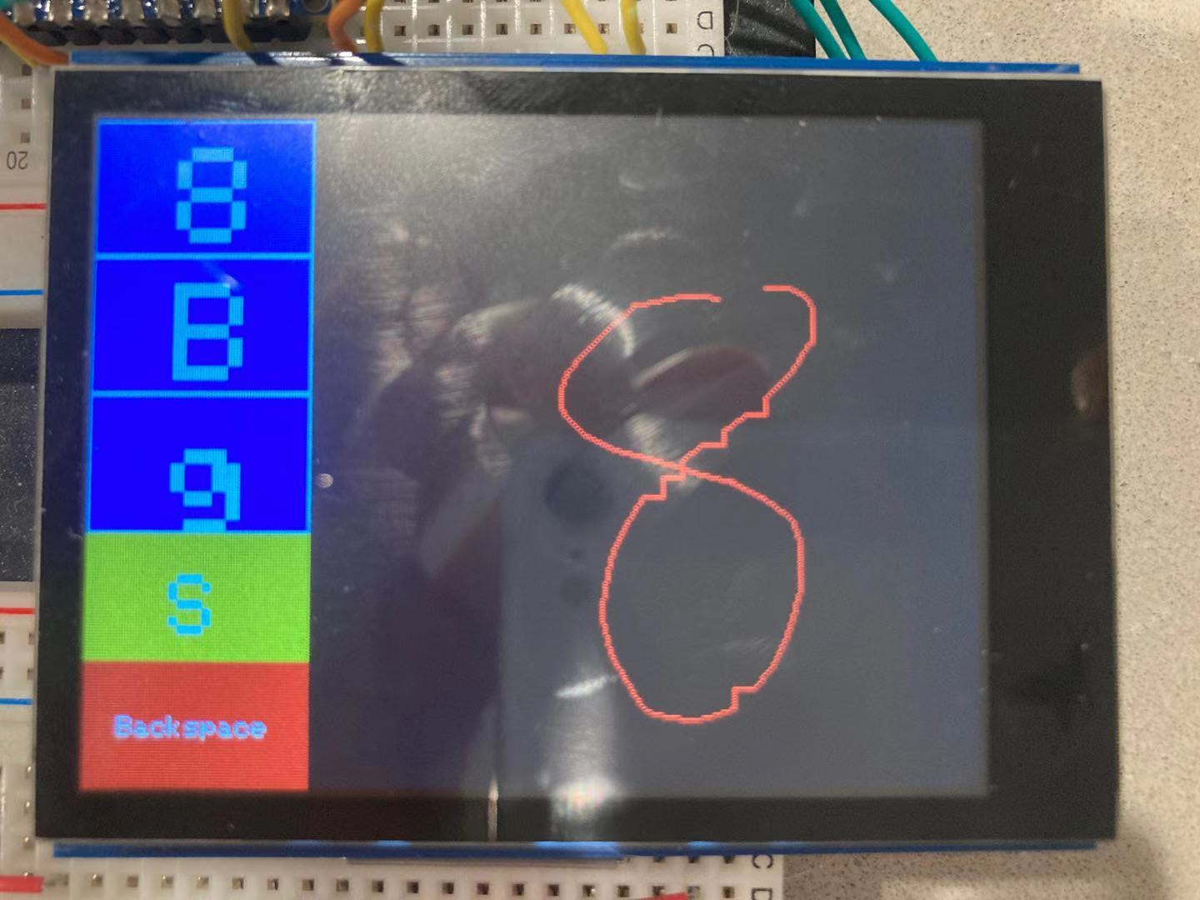
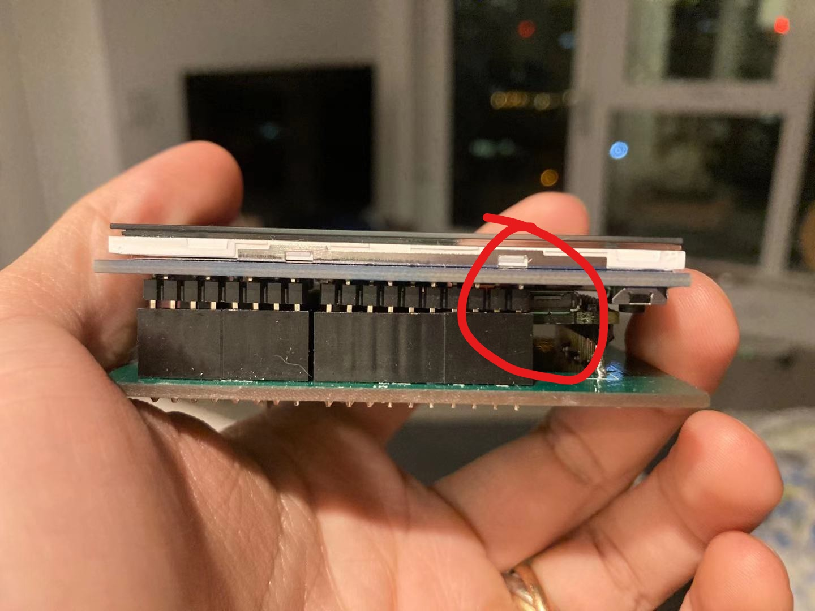
Conclusion & Discussion
Future work
1. Fix the limiting SPI speed.
2. Optimize mechanical design.
3. Considering adding booster converter to supply 5V to touchscreen.
4. Add switch and charging port for the battery.
5. Evaluate the accuracy with different users.

